Slide 1


PES online Services to Clients in Slovakia
www.istp.sk – major leap towards e-services

Slide 2
F e a t u r e s
► brand new IT platform launched in November 2013
► connects client´s profiles (automatically pre-generated) with occupations classification, competences, skills, and vacancies
► work potential profiling = individualized automated service
► new system of work with vacancies = online access to employers = online access to jobseekers
► email and SMS notification of vacancies
► Automatically generated reports on activity of registered jobseekers in their accounts

Slide 3
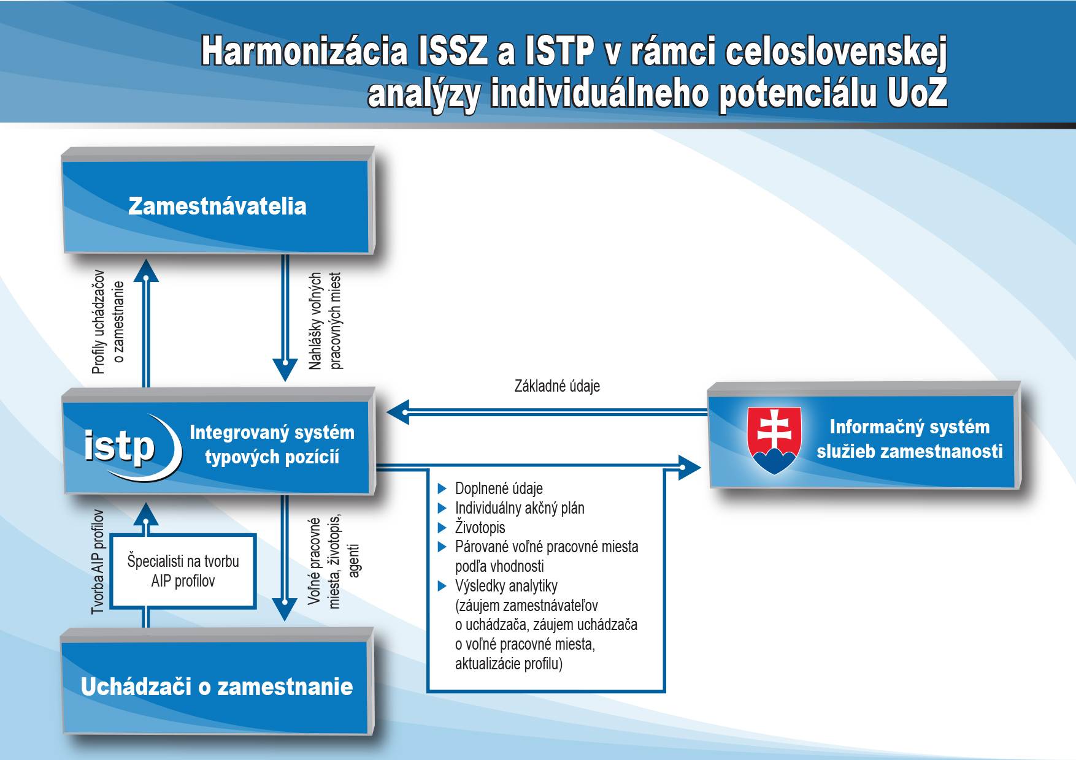
Harmonization of new back and front office IT systems
400ths. registered jobseekers´ profiles
Employers
Jobseeker´s offers
Vacancies offers
Basic profiles
Web portal
Back Office IT
Enhanced profiles:
Completed JS file
CV
IAP
Matched VSs
Activity of JS
JVs
Agents
Creation of analysis of individual ´s potential
Profiles of not registered JSs
Jobseekers

Slide 4
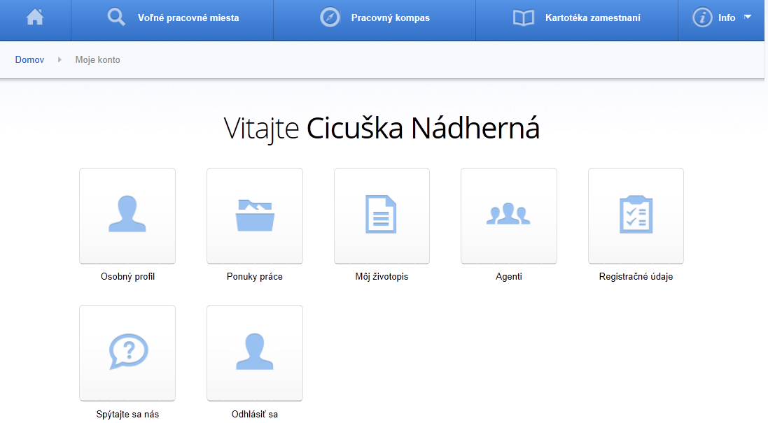
Client´s account
Welcome “client XY“
Welcome “client XZ“
Personal Profile
My Job Offers
My CV
My Job Agents
Registration data
Ask Us
Sign Out

Slide 5
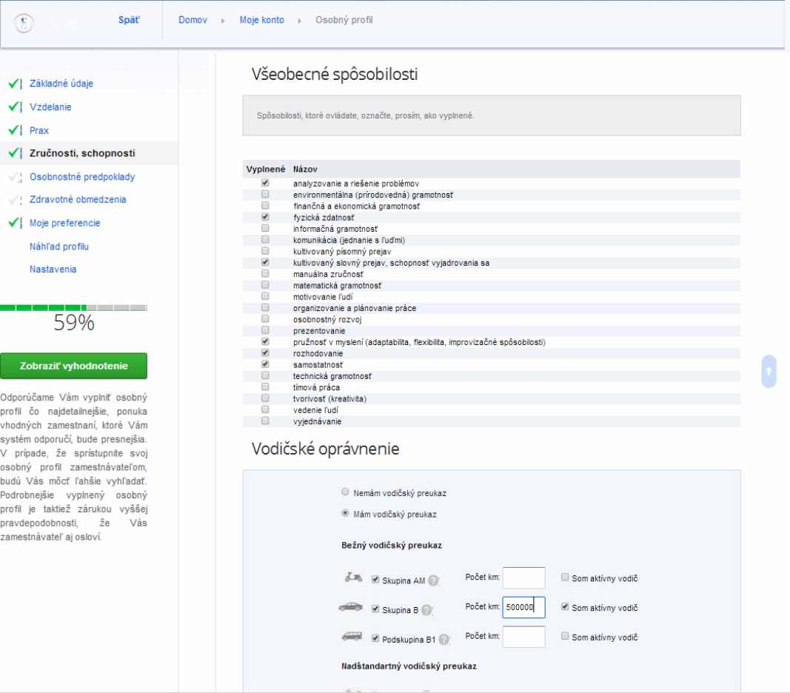
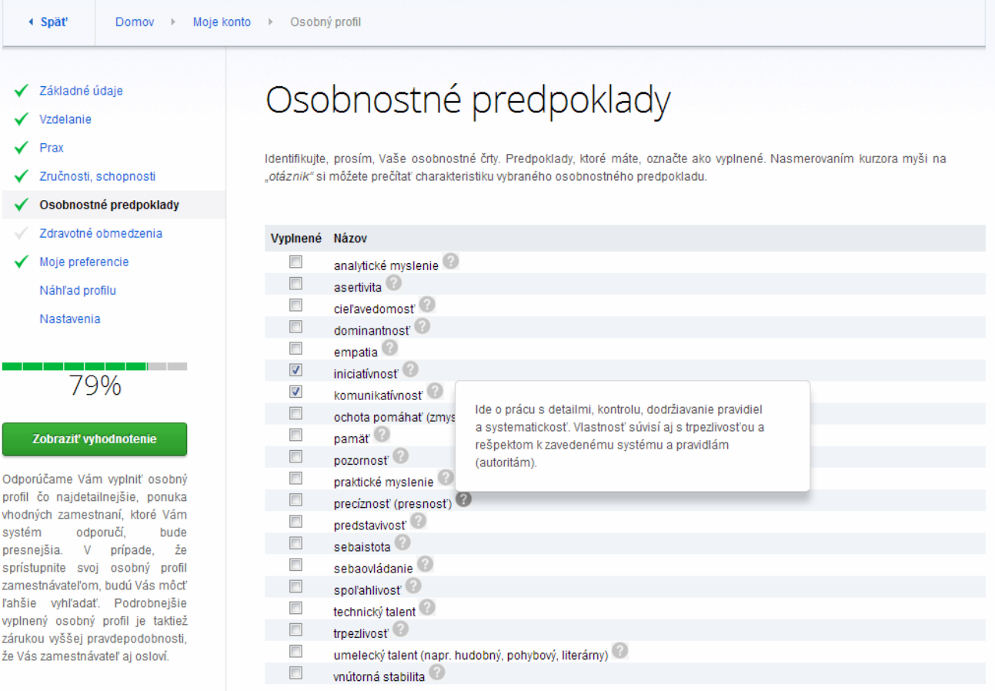
Client´s account
Competences
General competences
Personal preconditions

Slide 6
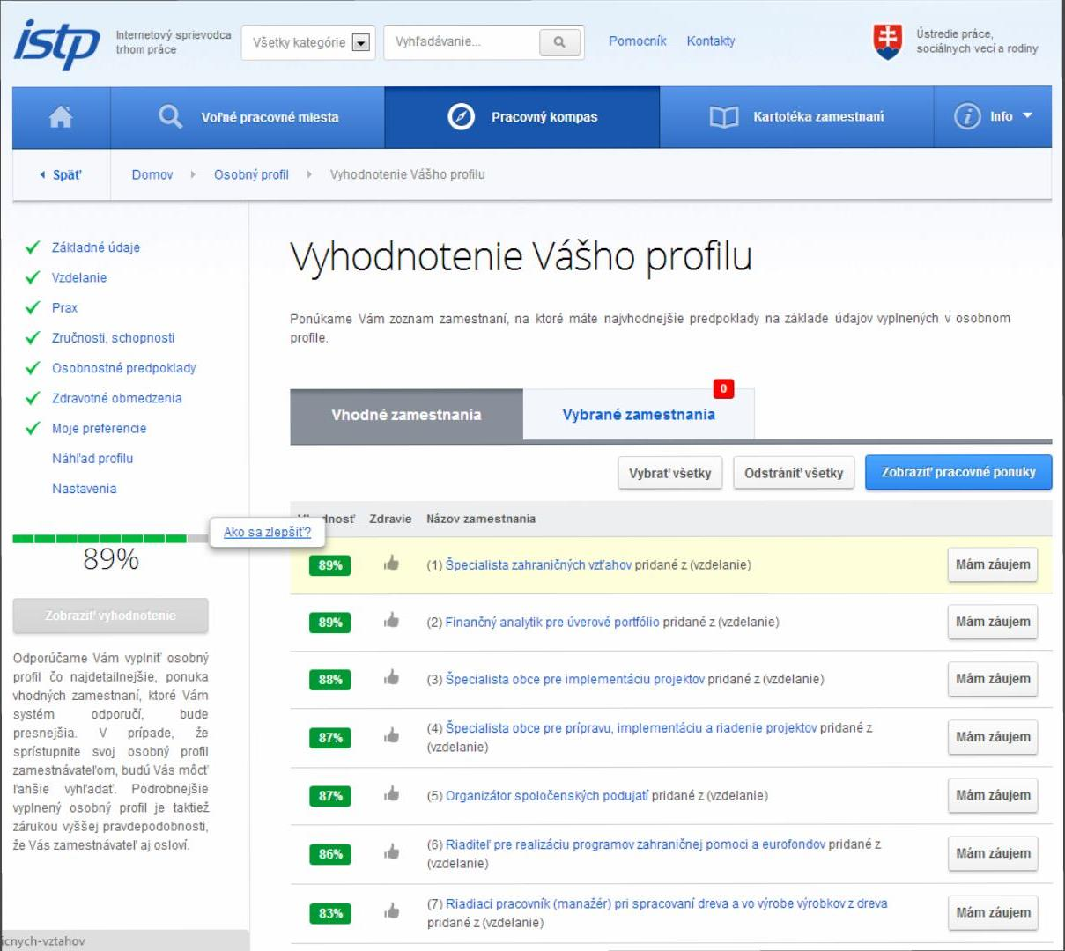
Client´s account
Professions Matching
  Automated matching of client´s profiles with:
  Professions´ matching takes into account not just hard skills, formal education and other ordinary criteria, but also soft skills and competences.
  Ranking according to suitability
  Suggestions for fitting better
Profile Evaluation
Suitable professions
I am interested
How do I get better?

Slide 7
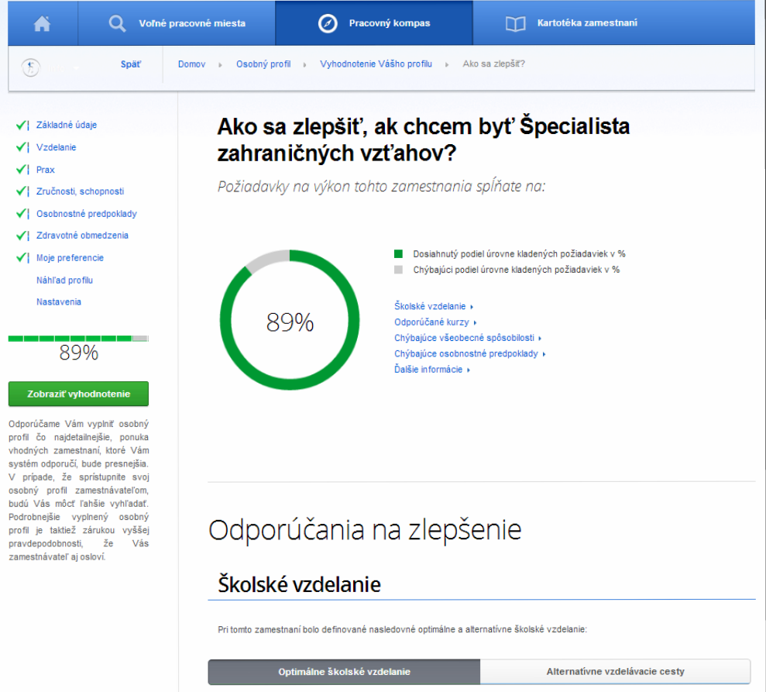
Client´s account
Work Compass
How do I get better if I want to become “.......“
Recommendations on how to get better
Alternative educational pathways
Education
Optimal Formal Education

Slide 8
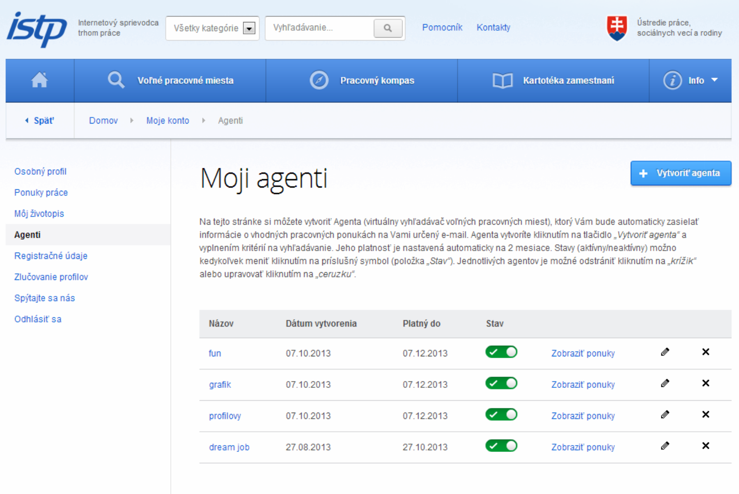
Client´s account
My Agents
My Job Agents
Create new Agent
Display job offers

Slide 9
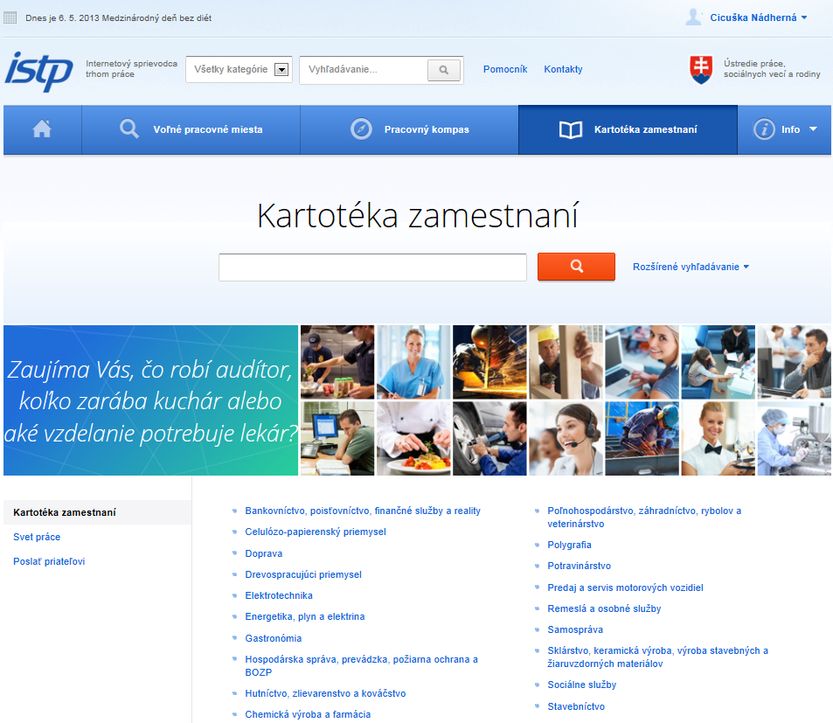
Client´s account
Register of Professions
  “Does it interest you what an auditor does, how much a chef makes or what education you need to have for becoming a doctor?“
  Descriptions of professions:
  Education, certificates
  Knowledge
  Skills and competences
  Experiences
  Wages

Slide 10
Advantages of e -profiling
    ► unified e-forms of questionnaires
    ► Work potential analysis according to source/input data
    ► recommendations for job mediation – “tailor made“ vacancies
    ► recommendations for counseling process and career panning
    ► motivating the client to work with his/her profile
    ► mediating profiles to employers
    ► job matching – e – notification on match
    ► better quality database on clients
    ► data flows – lowering of administrative burden

Slide 11
Employer´s account
Features
  Direct access to all registered jobseeker´s profiles
  Free of charge email and sms notification of selected clients
  (multiple invitations for interviews)
  Automated import of employer details from Business register
  Automated export of vacancies directly from employers IT system to istp.sk
  Ranking of suitable jobseekers
  “My jobseekers“

Slide 12
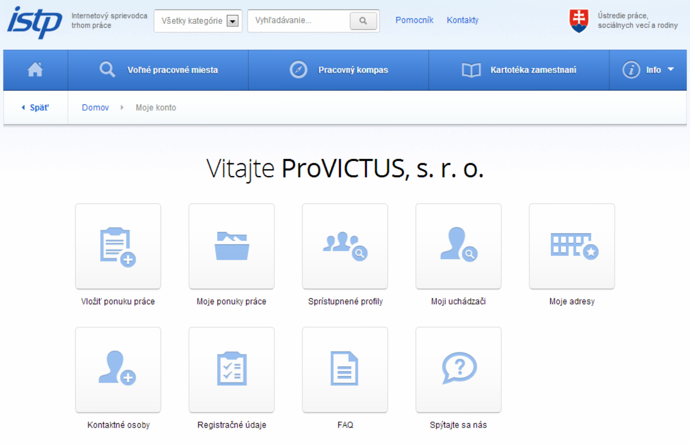
Employer´s account
Welcome “employer XY“
Welcome “employer XZ“
Insert Job Offer
My Job Offers
Accessing Profiles
My Jobseekers
My adresses
Contact Persons
Registration Data
Ask Us

Slide 13
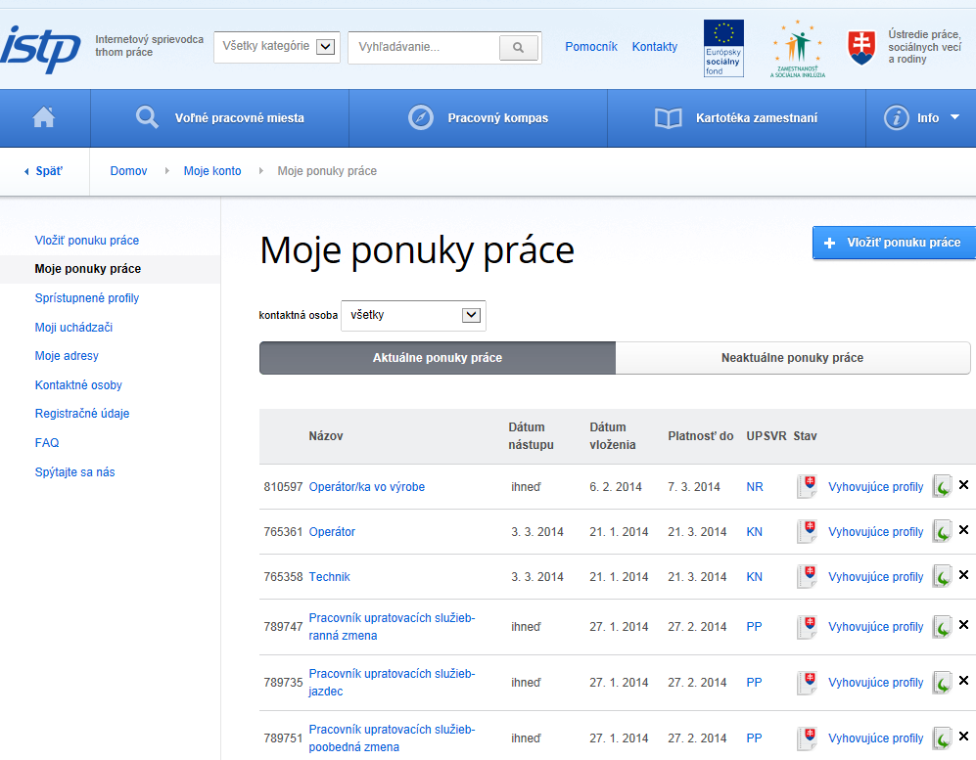
Employer´s account
My Job Openings
Matched profiles

Slide 14
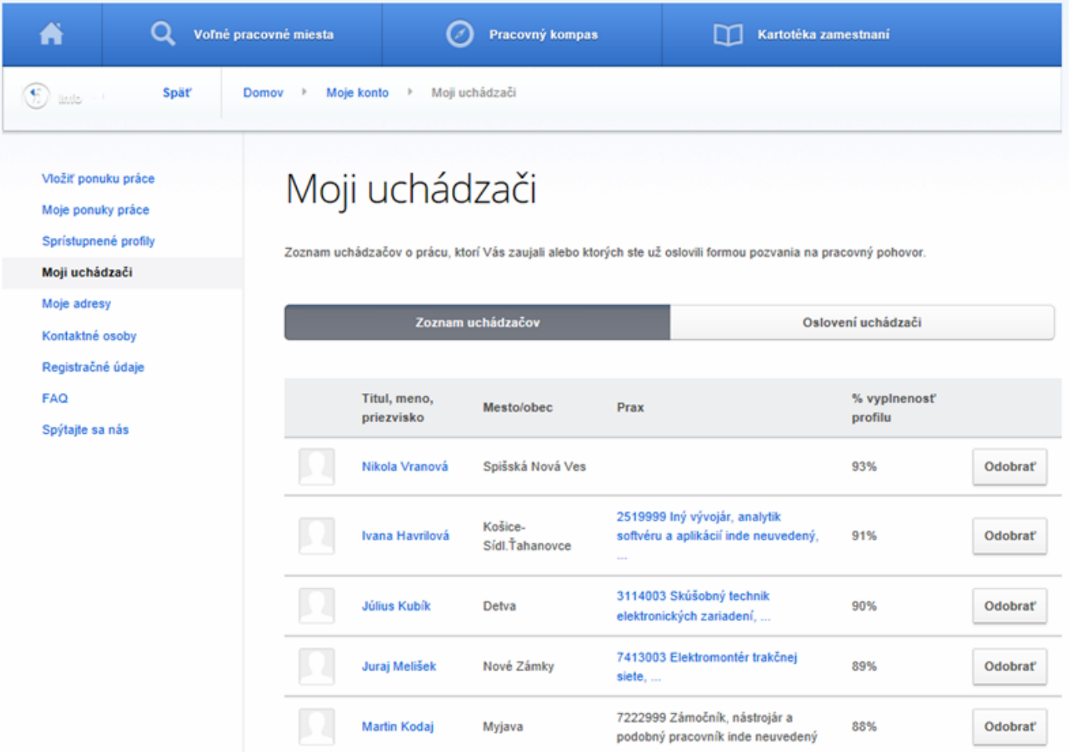
Employer´s account
My Jobseekers
Discard

Slide 15
A c h i e v e m e n t s
(s o f a r)
    ► Effective, time-saving and quality service!!!
    ► Automated migration of job vacancies from other job portals
    ► Extremely positive interest of employers so far, more than 3 000 registered employers (within first 3 months);
    ► The biggest pool of vacancies at Slovak LM within a month (now about 12 000 and still growing...)
    ► Over 42 000 personal profiles activated (+ almost 400 ths. accounts pre- generated)
    ► over 500 000 accesses each month

Slide 16
Thank you for not falling asleep!!
☺
boris.katuscak@upsvr.gov.sk

