Slide 1


Future Skills Need and the role of PESs
Tibor Bors Borbély-Pecze, Ph.D
Senior Consultant
V4 & CPESSEC seminar
Budapest, 26 February 2014

Slide 2


Challange
CENTRAL EUROPE Programme (2013)

Slide 3

Definition(s)
Skills mismatch is defined as the gap between an individual’s job skills and the demands of the job market; it has become a central challenge for Europe, affecting all layers of society, from the productivity and efficiency of businesses to the current and prospective welfare of youth.
(in Youth Attitudes to the job market)

Slide 4
Definition(s) /2 Shortages vs. gaps; UK
Skills shortages arise when employers find it difficult to fill their vacancies with appropriately skilled applicants. There are relatively few skills shortages in the UK but it is important to measure them by sector and occupation to identify those activities in which they do have a significant impact.
Skills gaps arise where members of the existing workforce are seen to lack the skills necessary to meet business needs. Skills gaps are far greater in number than skills shortages; it is also important to measure skills gaps by sector and occupation. Defining skill shortages is far from straightforward. The Migration Advisory Committee (MAC) (2008) in an extensive review highlights that the only consensus on these matters is that there is no single measure (either conceptually or practically) that suits all needs.
UK Commission for Employment and Skills (UKCES) https://almanac.ukces.org.uk/Skills/What%20are%20skills%20mismatches/Forms/AllItems.aspx

Slide 5
Definition(s) /3: OECD Skills Strategy
Skills have become the global currency of the 21st century. Without proper investment in skills, people languish on the margins of society, technological progress does not translate into economic growth, and countries can no longer compete in an increasingly knowledge-based global society. But this “currency” depreciates as the requirements of labour markets evolve and individuals lose the skills they do not use. Skills do not automatically convert into jobs and growth.
OECD (2012) Skills Strategy

Slide 6
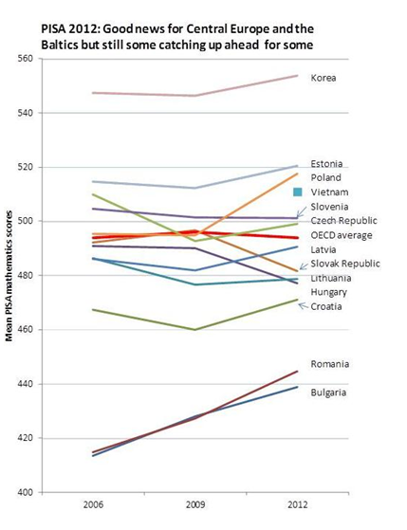
OECD PISA (2012): role of the fundamental skills and early interventions

Slide 7
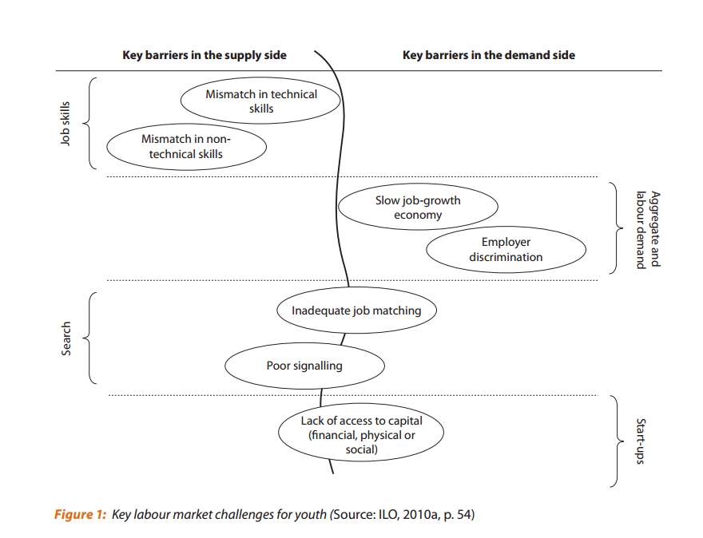
Challanges of the labour market (ILO)

Slide 8
What can PES do and what cannot?
… register applicants for employment, take note of their occupational qualifications, experience and desires, interview them for employment, evaluate if necessary their physical and vocational capacity, and assist them where appropriate to obtain vocational guidance or vocational training or retraining, ..
(ILO: C88)

Slide 9
Elements of the PES toolbox: training
Labour market training measures are those undertaken for reasons of labour market policy, other than special programmes for youth and the disabled. Expenditures include both course costs and subsistence allowances to trainees, when such are paid. Subsidies to employers for enterprise training are also included, but not employer’s own expenses. (OECD, 2001)
http://stats.oecd.org/glossary/detail.asp?ID=1488

Slide 10
Elements of the PES toolbox: training/2
often targeting special groups (e.g. YGI sub-groups of NEETs),
paradigm of LLL become a European answer, also influences LM training as ALMP
  continuous professional development/ education (CPD/E) from the 80’s has become a basis for most of the professions not only for the highly skilled workers.
These different demands require short but often long term training courses, general and professional forms from the PES side and it might generate contradictions.

Slide 11
Elements of the PES toolbox: LM prognosis
There are two major approaches to occupational forecasting:
workforce projection
and labour market analysis (signalling).
Workforce projection produces longer-term federal and provincial forecasts, while labour market analyses (LMA) identify and continually adjust to current regional and short-term trends.
These signals are available via newspaper job listings or from the provincial and public employment and social insurance services that collect information about job openings, placements and unemployment rates.
(CCL, CA 2007)

Slide 12
Elements of the PES toolbox: LM prognosis /2
Challenges;
short term (signalling) and long-term (projections) are often mixed
connections between PES and schools and adult educators are varies from country to country
training as ALMP and PES as an organisation not always able to follow the needs (based on the outcomes of the signals)
links between PES and other partners (e.g. Central Statistical Offices, universities, CEDEFOP, etc.) need to have more attention
developing and running these type of system require highly skilled staff ….

Slide 13
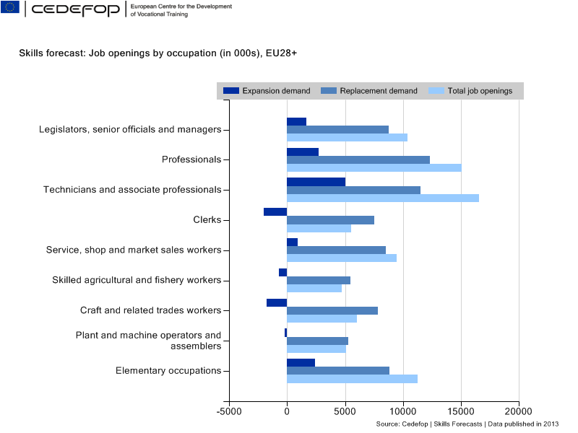
Current EU prognosis model

Slide 14
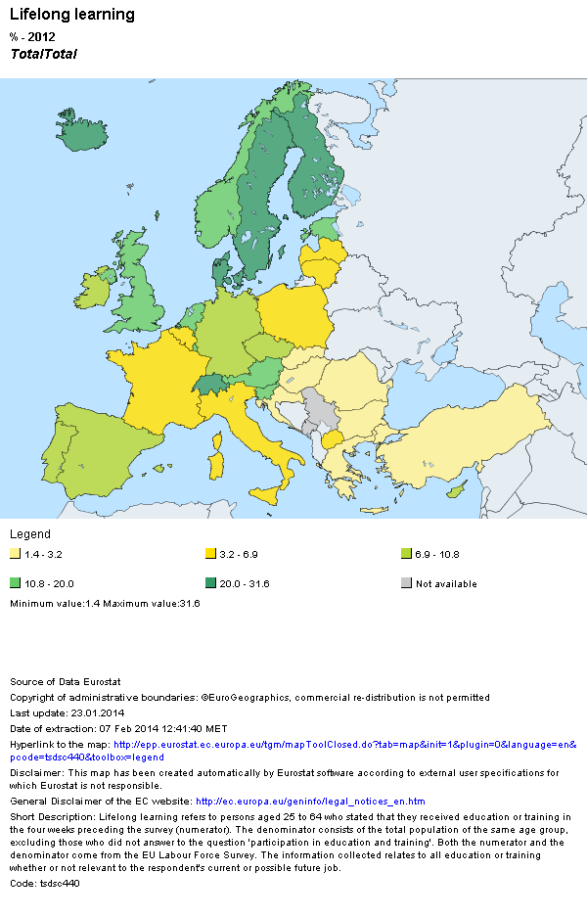
How far are we from this in the
CEE & Balkan region? (LLL %, 2012)

Slide 15
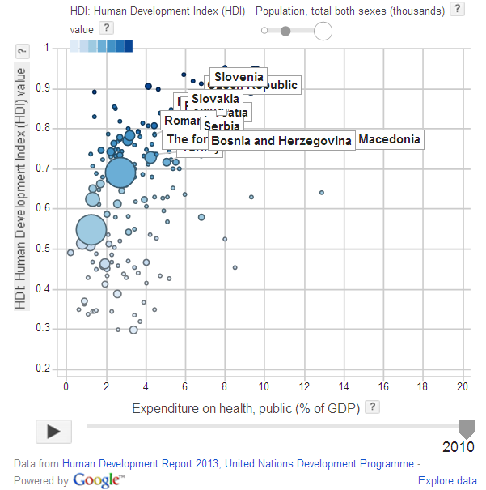
How far are we from this in the
CEE & Balkan region? (HDI, 2013)

Slide 16
Open questions for the workshop
Training and vocational training as an active labour market policy tool;
How would you define the nature of labour market training programmes? Is it closer to CPD/E or traditional VET programmes?
Which sector feel stronger ownership for VET schools or employment services?
Are the meaning of skills clear in your national context?
Roles of labour market prognosis;
Who run labour market prognosis in your country?
Is there a debate (at any level, e.g. role of the sector councils, chambers, social partners) about the reliability of these prognoses?
If your PES is carrying out labour market prognoses how do you aggregate the occupational demands?

Slide 17
Thank you for your attention and looking forward to work with you in the workshop
Tibor Bors Borbély-Pecze, Ph.D.
Senior Consultant
borbelytibor@lab.hu

